Slide 1

Team Name : KnowledgeExtractor
Team Leader Name : Muhammed Sahil
Problem Statement : Healthcare QA teams waste 60% of their time on manual compliance test creation, causing costly errors and delaying patient access to critical technologies.

Slide 2
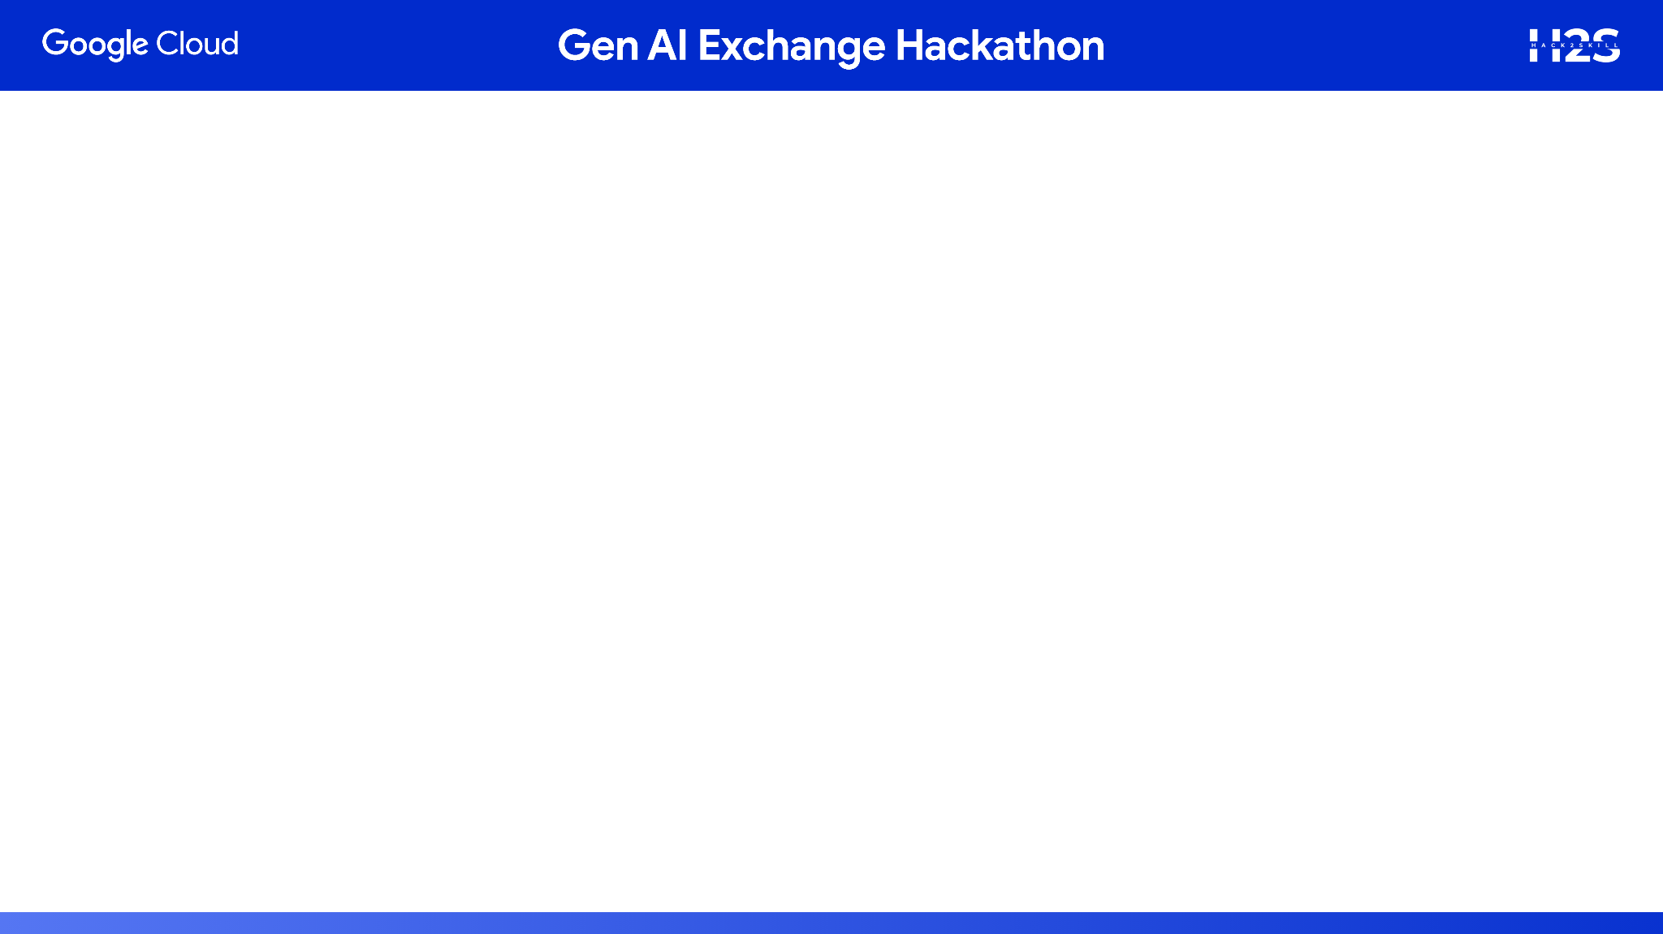
KnowledgeExtractor AI: An Overview
First AI-powered system that automatically converts healthcare software requirements into compliant, traceable test cases with full enterprise ALM integration.
Built on Google Cloud AI, it transforms dense regulatory documents (from bodies like the FDA, IEC, and ISO) into comprehensive QA test suites in minutes, not weeks. Our working prototype demonstrates this end-to-end flow, from document upload to live Jira export and audit-ready evidence generation.

Slide 3
How is it different?
- Existing QA tools are generic, lacking specialized healthcare knowledge.
- Our solution is the only AI system with native FDA, IEC 62304, and ISO 13485 compliance automation.
How will it solve the problem?
- Automates the most time-consuming, high-risk QA tasks.
- Reduces manual effort by 99%+, eliminates human error, and ensures audit readiness.
USP:
- The only AI solution combining healthcare regulatory expertise with compliance validation and ALM integration.

Slide 4
Core Capabilities of KnowledgeExtractor AI
- AI-Powered Document Processing (PDF, Word, XML with Google Document AI)
- Compliance-Aware Test Generation (FDA 21CFR820, IEC 62304, ISO 13485)
- Enterprise ALM Integration (Jira, Polarion, Azure DevOps)
- One-Click Audit-Ready Evidence Bundle
- Business Impact Analytics (ROI, risk coverage, compliance alignment)

Slide 5
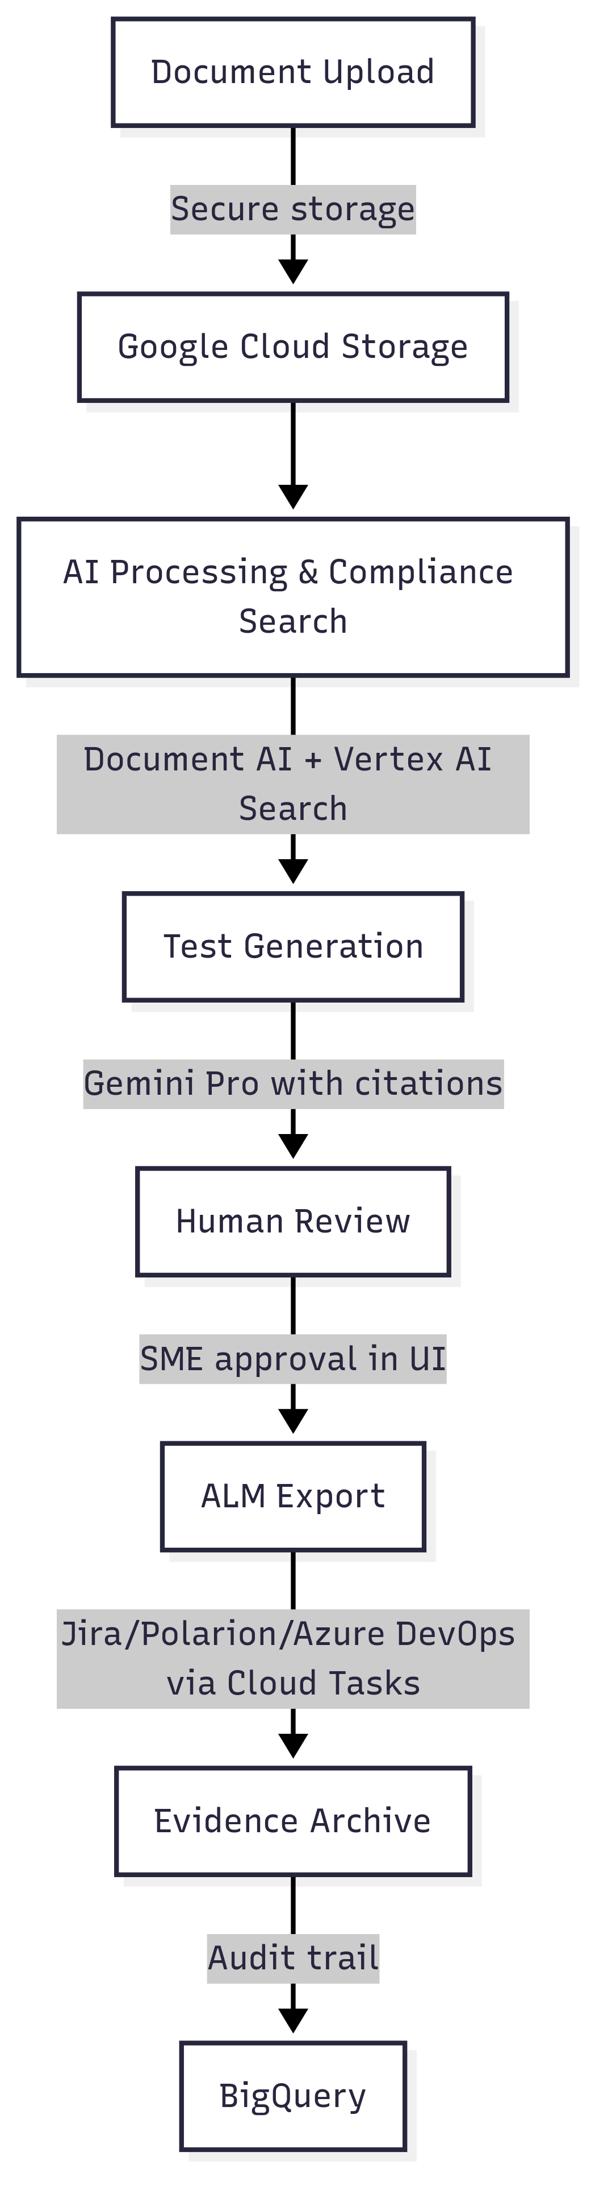
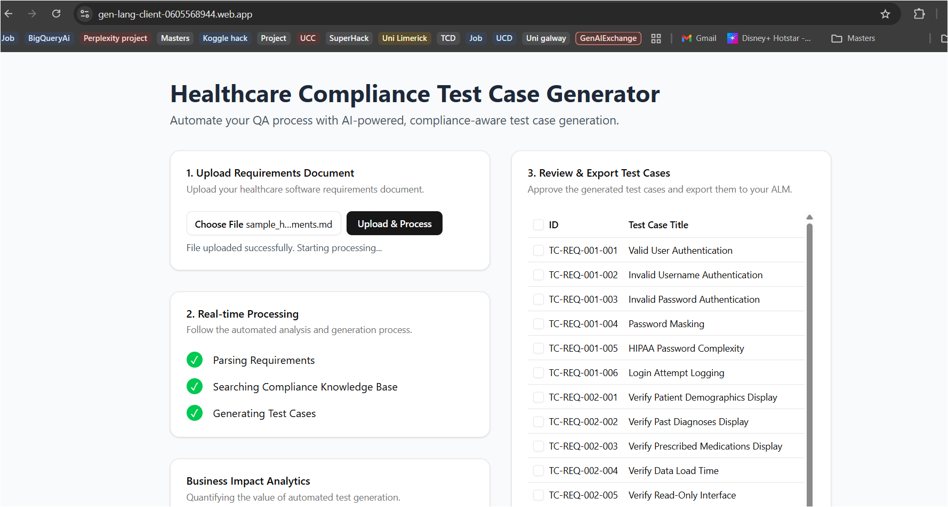
End-to-End Automated Workflow

Slide 6
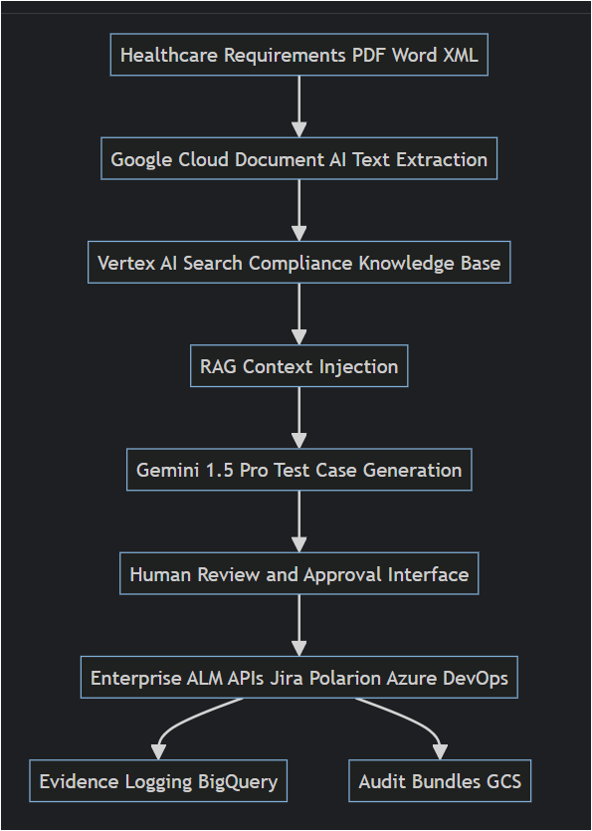
Scalable & Secure Google Cloud Architecture

Slide 7
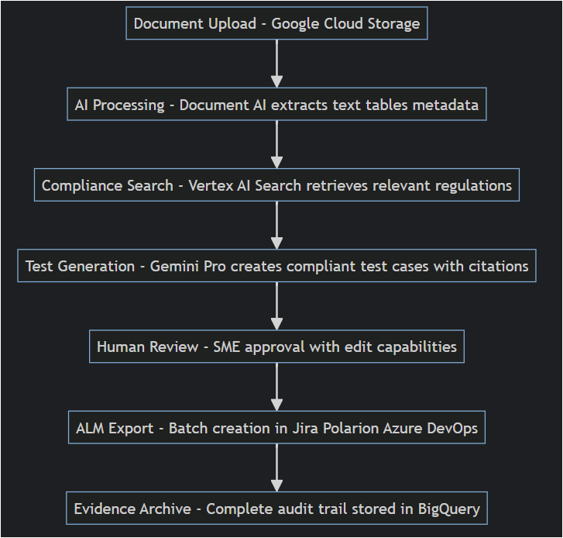
Architecture diagram of the proposed solution

Slide 8
Technologies to be used in the solution:
- AI/ML: Vertex AI (Gemini 1.5 Pro, Document AI, Search)
- Frontend: Next.js 14, Tailwind CSS, SSE
- Backend: Node.js, Google Cloud Run, Cloud Tasks
Storage & Data: Google Cloud Storage, BigQuery
Security & Integration: IAM, Secret Manager, OAuth 2.0, REST APIs
Fire Base: Hosting the application

Slide 9
Estimated implementation cost
Demo Scale (monthly): ~ $920
- Document AI: ~$250
- Vertex AI Search: ~$500
- Gemini Pro API: <$100
- Cloud Run & Tasks: <$50
- BigQuery: ~$20
Enterprise Scale: ~$6,300
ROI: Mid-size healthcare company saves $1M+ annually, 300-500% ROI in 18 months.

Slide 10
Summary
- Clear Business Value: Addressing a $23.95B market
- Working Prototype: Live demo shows end-to-end functionality
- Innovative Technology: Built with Google Cloud AI (Gemini, Vertex AI, Document AI)
- Complete Vision: Covers problem, architecture, and business impact

Slide 11


